Slide 1
On the Creation of the BeSiVa Algorithm To Predict Voter Support: Figures and Tables
By Benjamin Rogers

Slide 2
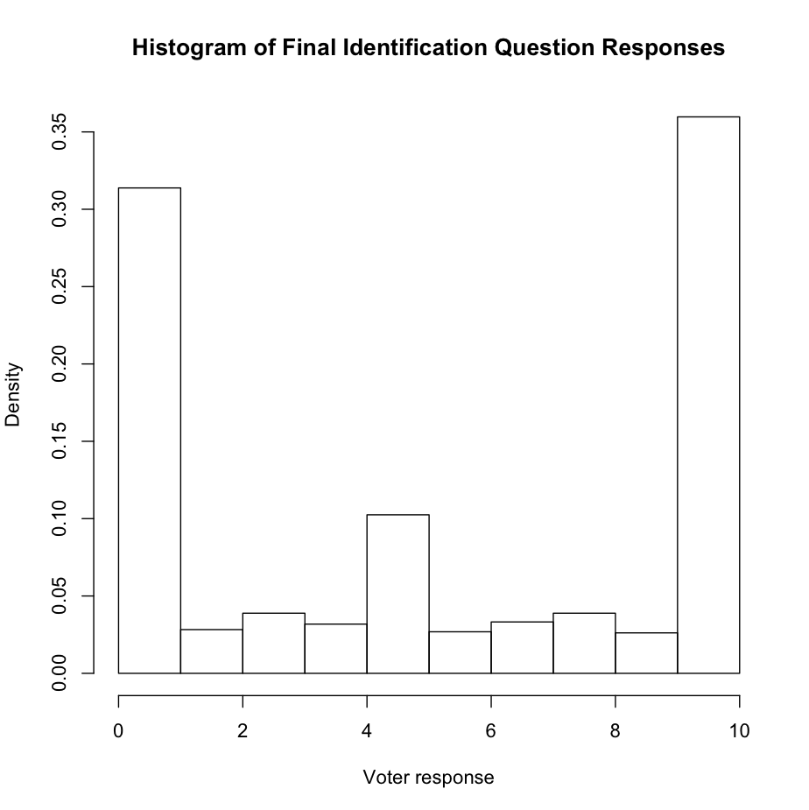
Histogram of Collected Data

Slide 3
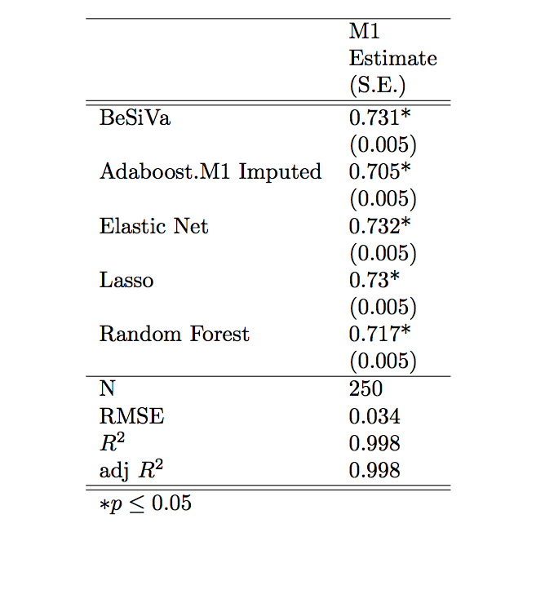
Bootstrapped Data Results

Slide 4
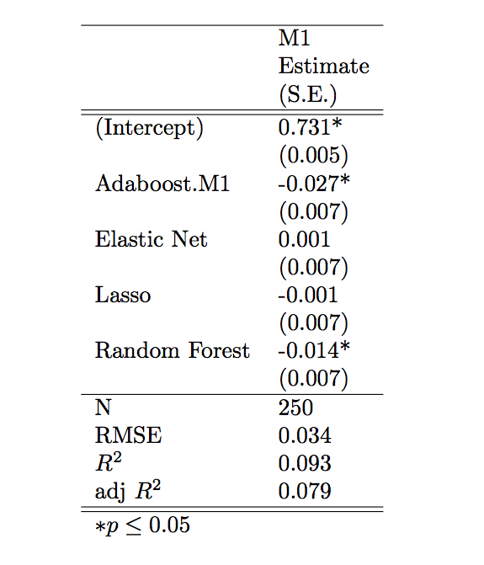
Treatment Contrasts of Bootstrapped Data Analysis

Slide 5
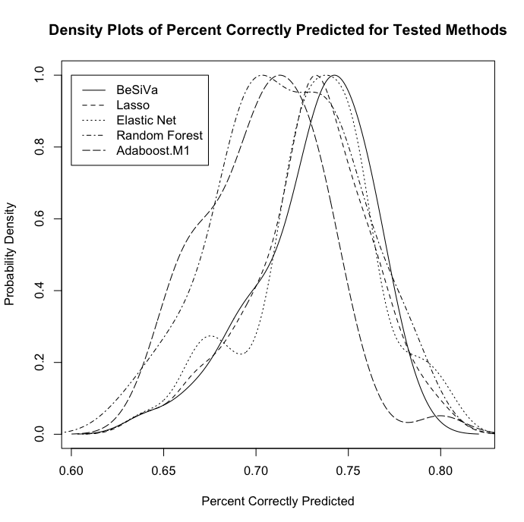
Density Plot of Results

